Slide 1
Module3 Introduction to fixed-income valuation
Yield spreads over benchmark rates
The benchmark captures the macroeconomic factors
The spread captures the microeconomic factors
Spread | →→ | Risk premium | →→ | Taxation
 |  |  |  | Liquidity
 |  |  |  | Credit risk
Benchmark | →→ | Risk free rate of return | →→ | Expected inflation rate
 |  |  |  | Expected real rate

Slide 2
Module3 Introduction to fixed-income valuation
Yield spreads over benchmark rates
Fixed-rate bonds often use a government benchmark security with the same time-to-maturity as, or the closest time-to-maturity to, the specified bond.
A frequently used benchmark for floating-rate notes has long been Libor, which is due to be phased out, with the Market Reference Rate to take its place.
The yield spread in basis points over an actual or interpolated government bond is known as the G-spread.
The yield spread of a specific bond over the standard swap rate in that currency of the same tenor is known as the I-spread or interpolated spread to the swap curve.

Slide 3
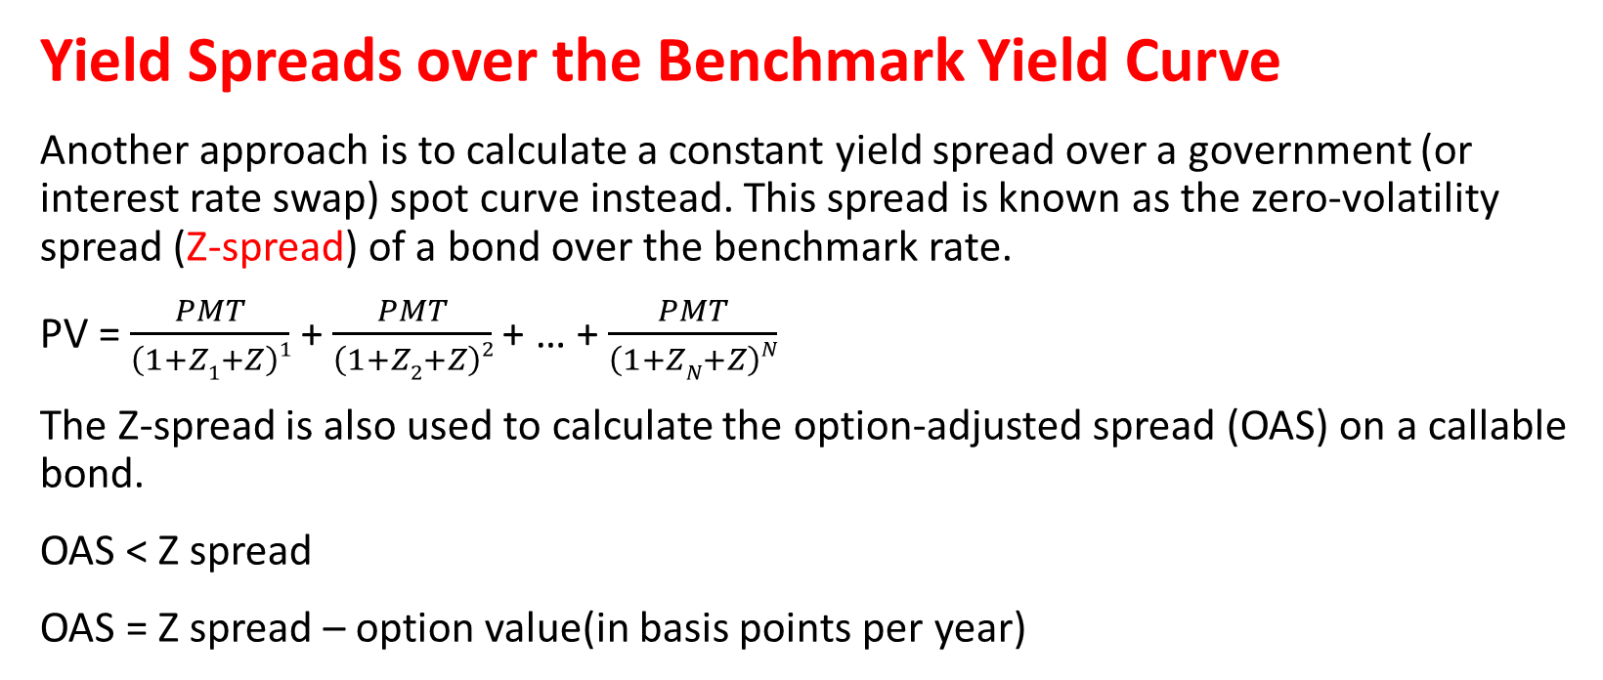
Module3 Introduction to fixed-income valuation
Yield Spreads over the Benchmark Yield Curve
Another approach is to calculate a constant yield spread over a government (or interest rate swap) spot curve instead. This spread is known as the zero-volatility spread (Z-spread) of a bond over the benchmark rate.
PV = $\frac{PMT}{\left(1+Z1+Z\right)1}$ + $\frac{PMT}{\left(1+Z2+Z\right)2}$ + … + $\frac{PMT}{\left(1+ZN+Z\right)N}$
The Z-spread is also used to calculate the option-adjusted spread (OAS) on a callable bond.
OAS < Z spread
OAS = Z spread – option value(in basis points per year)

Slide 4
practices
A 6% annual coupon corporate bond with two years remaining to maturity is trading at a price of 100.125. The two-year, 4% annual payment government benchmark bond is trading at a price of 100.750. The one-year and two-year government spot rates are 2.10% and 3.635%, respectively, stated as effective annual rates.
1. Calculate the G-spread, the spread between the yields-to-maturity on the corporate bond and the government bond having the same maturity.
2. Demonstrate that the Z-spread is 234.22 bps.

